Slide 1
Positive Deviance:
Looking for the Exceptions
Presentation Mark Sundby, M.Div., Ph.D., LP
Edgewalker Café
July 10, 2023, 11:00 – 12:30 ET
Via Zoom

Slide 2
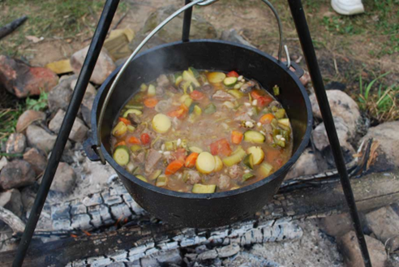
The Ladle Story
Ketchua Indians,
Altiplano, Bolivia

Slide 3
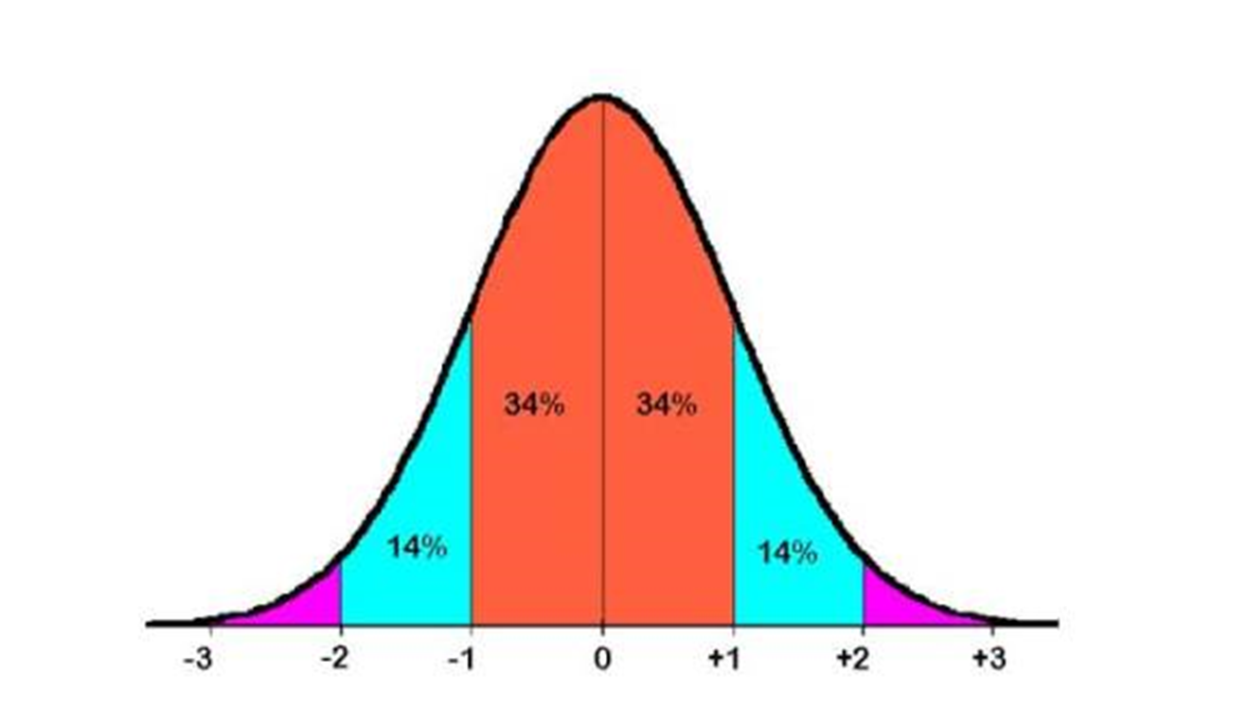
Positive Deviance Defined
The PD concept is based on the observation that in every community or organization, there are a few individuals or groups who have found uncommon practices and behaviors that enable them to achieve better solutions to problems than their neighbors who face the same challenges and barriers.
Pascale, Richard; Sternin, Jerry; Sternin, Monique. (2010). The Power of Positive Deviance . Harvard Business Review Press.

Slide 4
Other Key Elements
Assumption: communities have untapped assets and resources
PD individuals or groups have atypical behaviors or strategies that tap these resources
Inductive approach – no theory or experts, only principles to follow
The 4 D’s –
Define the problem
Determine common practices at local level
Discover uncommon behaviors and practices through observation
Design action learning based on findings

Slide 5
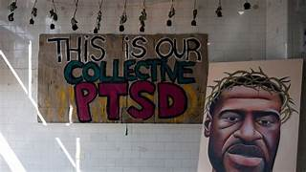
Polarization in Minnesota
Political Polarization - 2016 Elections
Religious Polarization - Christians vs. Muslims (“vs.” intended)
74% identify as Christian vs. 5% other religions
Rapid growth of Islamic population since the 1990s due to refugees
Largest Somali population in the United States
Mosque attacks by Christian Nationalists
Racial Polarization, Murder of George Floyd, May 25, 2020
Black Lives Matter vs. Blue Lives Matter
Defund the Police Movement vs. Call for Law & Order
Economic and Educational Disparities, White vs. BIPOC

Slide 6
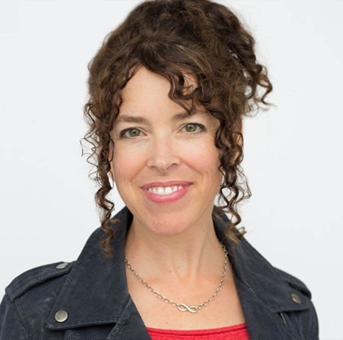
Local Writer
Goal - Encourage local students to write
“How to Write a Novel,” After School Class, 1 school, 15 students (2015)
Founded StoryArk, Non-Profit, (2016)
After Murder of George Floyd (2020) -
10 School Districts
1200+ Students
Guiding Principle -
“What’s your story? How do you want to tell it?”
Shahd, “My Hajib”, Visual Poetry
Current Mission -
“StoryArk helps students in elementary school, middle school, and high school initiate creative teams in which they communicate, collaborate and connect with each other to imagine and produce narrative podcasts, short films, and a literary magazine that publishes prose, poetry and visual arts.”

Slide 7
Original Story -
The World History Teacher and the Muslim Student
Heterogeneous Group – students of color, Muslim students, white students, Christian students, students of no religious background
Storyline – Conflict
•Clash of worldviews
•Postcolonial history in student’s country of origin
•Majority culture of white, male, Christian teacher and marginalized culture of African, female, Muslim student
•Resolution comes when meet in hospital before surgeries
Outcome – Empathy for both characters and empathy for others in their creative group

Slide 8
Identities and Roles - [Mariam]
Conflict Style: Compromiser
Lie: I’m not smart enough.
Democrat
Daughter
Sister
African
Identities
Muslim
Roles
Student
Mariam
Friend
Female
Strength//Weakness: Wants to make everyone happy//She can’t stand up for herself.
17
Singer
Social Style: Amiable

Slide 9
Identities and Roles - [Robert Smith]
Conflict Style: Competitive
Lie: I need to be right.
Republican
Father
Son
White
Identities
Christian
Roles
Teacher - World History
Robert
Smith
Husband
58
Strength//Weakness:
He gets his work done efficiently//He looks over people’s feelings for results
Male
Pet Owner
Social Style: Driver

Slide 10
StoryArk Outcome Research
“To what extent have I collaborated with students from other cultures?”
Pre Survey: 3.6 out of 5.0
Post Survey: 4.6 out of 5.0
Improvement = 28% increase in scores
“To what extent have I experienced working on a collaborative team to give and receive feedback and work with different perspectives and worldviews?”
Pre Survey: 3.4 out of 5.0
Post Survey: 4.7 out of 5.0
Improvement = 38% increase in scores
Positive Deviance definition -
The PD concept is based on the observation that in every community or organization, there are a few individuals or groups who have found uncommon practices and behaviors that enable them to achieve better solutions to problems than their neighbors who face the same challenges and barriers.

Slide 11
For addressing polarization…
Keep it local
Look for the exceptions - the positive deviants - in your community
No experts have the answers - Experiment!

Slide 12
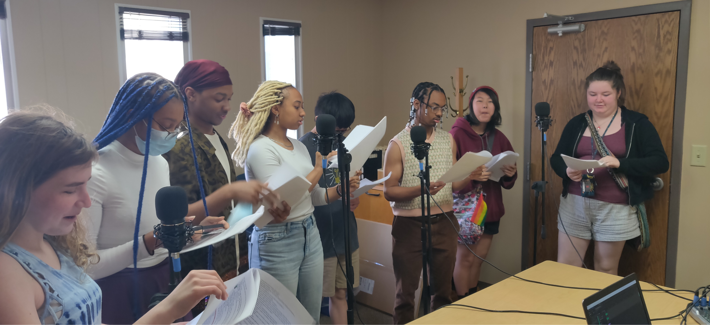
RAISE YOUR VOICE:
The Power of Story

Slide 13
Resources
Book
Pascale, Richard; Sternin, Jerry; Sternin, Monique. (2010). The Power of Positive Deviance. Harvard Business Review Press.
Websites
Positive Deviance Collaborative, www.positivedeviance.org
Story Ark, StoryArk – What's your story?

