Slide 1
Cultivating Egoence in a Polarized World
Presentation Kim Byas, Sr., PhD, MPH, FACHE
Edgewalker Café
July 10, 2023, 11:00 – 12:30 ET
Via Zoom

Slide 2
Presentation Thesis:
Living consciously requires egoence.

Slide 3
Presentation Outline
Change and Flux: A Constant
A Personal Example
Egoence: Embracing What is true
Method and Practice for Living with Egoence

Slide 4
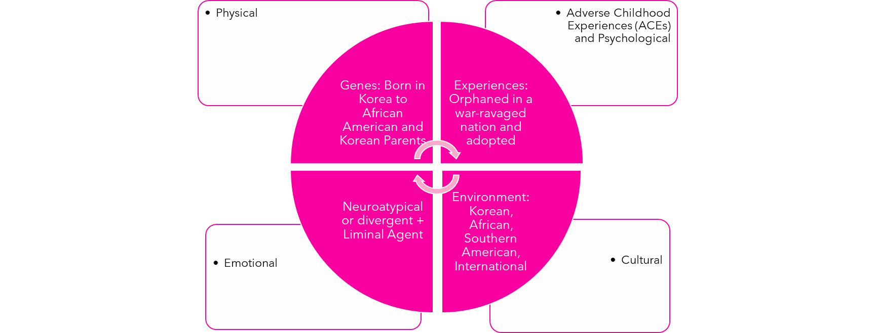
Personal Example of Consciousness

Slide 5
A Working Definition
Egoence is being conscious of ourselves in relationship to the whole; and discerning how to respond and accept the responsibility implied by that consciousness.
Source: Kutscherauer, J. L. (2007).

Slide 6
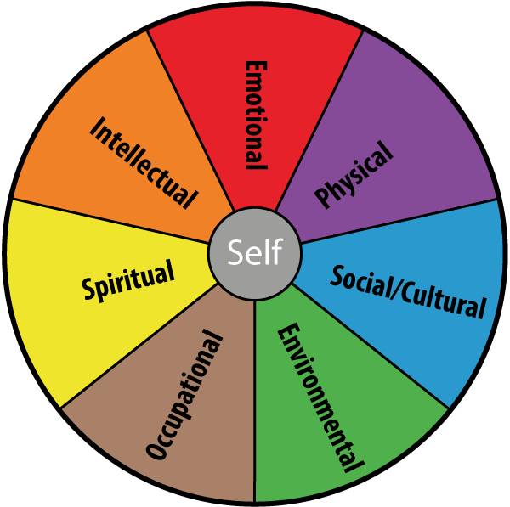
Egoence ≡ Consciousness of the Self + Contexts + Relationships
Source: https://timwalshcounselling.ie/wp-content/uploads/2014/08/diagram-for-blog-1.png

Slide 7
Consistent and Proven Methods for Nurturing Egoence
Being aware and conscious of one’s own feelings, thoughts, and actions.
Nurturing egoence and embracing the “…Other as sacred.” (Buber, 1970) through a well-established method that nurtures unfolding and egoence.
Spiritual practice;
Meditation; and
Journaling.

Slide 8
Summary
We live with constant change.
Consciousness leads to egoence.
Nurturing egoence requires a method and consistent practice.
Egoence supports a conscious life—even in a polarized world.

Slide 9
Resources
Buber, M., & Kaufmann, W.A. (1970). I and Thou. New York: Simon & Schuster. (https://drive.google.com/file/d/16g0n0k3-RXJ0gxKrM2DVCMEJ-Azz29K1/view?pli=1)
Cafhglobal.com (https://www.cafhglobal.com/)
Kutscherauer, J.L. (2007). Caring for our inner biosphere: Extract from the Closing Address from the Cafh Annual Assembly. Mendoza, Argentina: Cafh Order (https://www.seedsofunfolding.org/articles/features-list/36-caring-for-our-inner-biosphere.html).

Slide 10
Cultivating Egoence in a Polarized World
Kim Byas, Sr., PhD, MPH, FACHE
Founder and CEO, Leadership Lessons From…
+1 312-404-9667
kbyassr@leadershiplessonsfrom.org
www.leadershiplessonsfrom.org

