Slide 1
Understanding Polarization from Social Science Frameworks
Graham Hart, M.Div. Th.M.
LeaderWise Staff Associate –
Coach, Consultant, Conflict Mediation
graham@leaderwise.org

Slide 2
Why, as human beings, do we see the world in such different and polarizing ways?
How us/them and ingroup/outgroup clustering is innate to being human and also dangerous for the future of humanity.
Why do the differences in our moral make-up incline us to different world views?

Slide 3
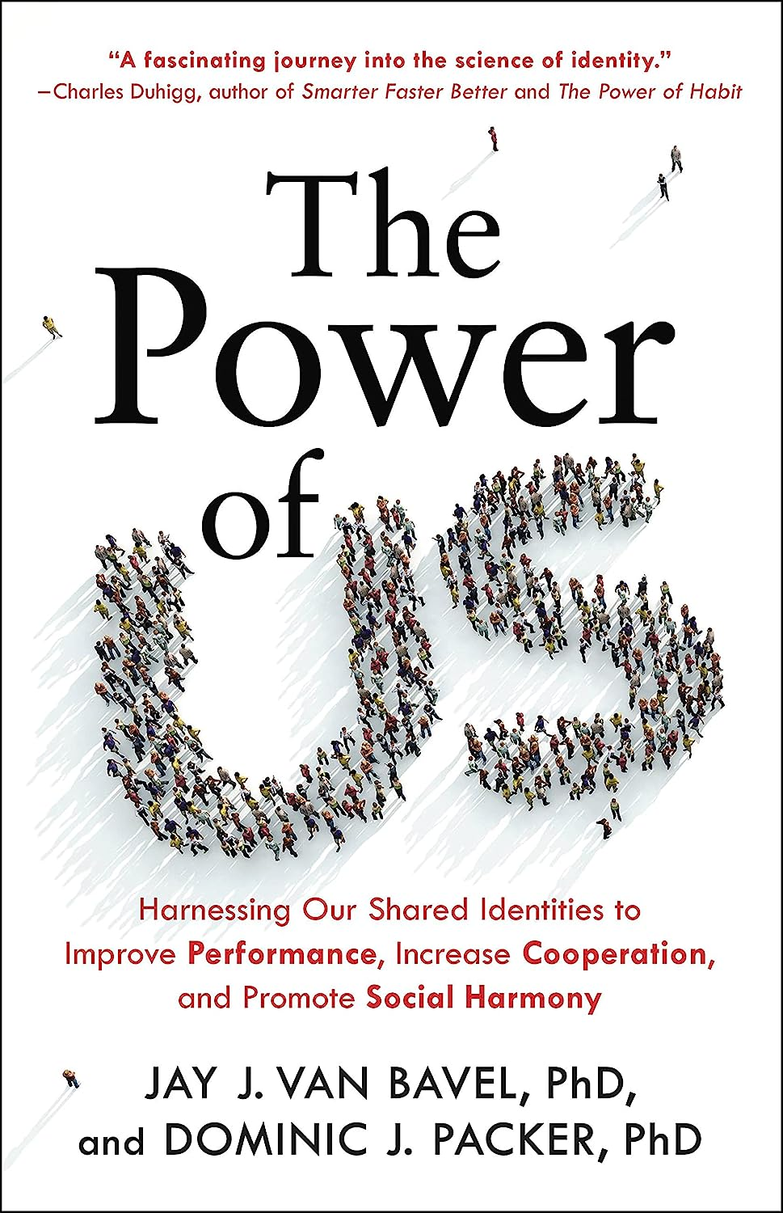

Slide 4
The Power of Us: Harnessing Our Shared Identities to Improve Performance, Increase Cooperation, and Promote Social Harmony

Slide 5
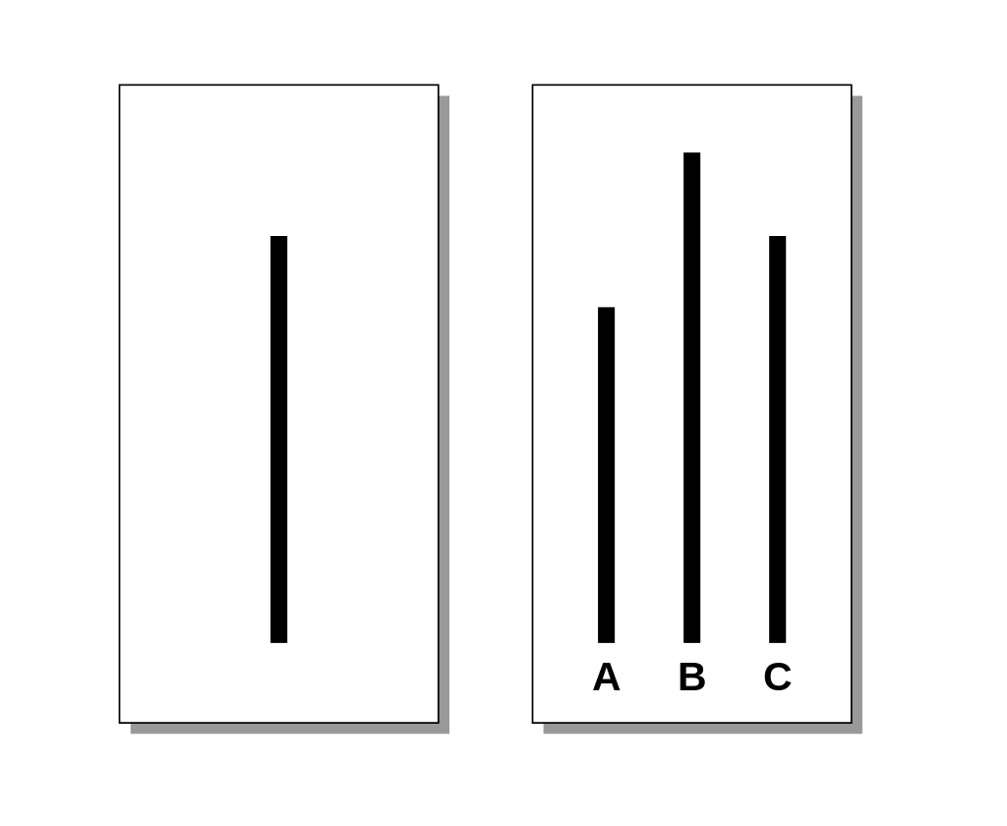
Asch conformity experiments

Slide 6
The Righteous Mind:
Why Good People Are Divided by
Politics and Religion
Harnessing

Slide 7
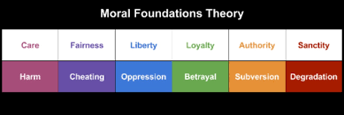

Slide 8
Some Next Steps
Today’s divides are all part of being human – it is our human family for better and worse. So, encourage you to read these 2 books.

Slide 9
Some Next Steps
Become part of the growing grassroots movements that are lifting up a common universal vision.
Without a vision the people will perish.

Slide 10
Some Next Steps
A bold proposal –the creation of a $$$ fund whose purpose is to build a global collaborative network that brings together people and organizations committed to the Flouring of all.

Slide 11
THE FLOURISHING FOR ALL FUND
PURPOSE
To develop a Flourishing For All Social Media Platform.
To fund the creation of video and written content for social media and the internet.
To curate the massive amount of research, articles, videos, and work related to the flourishing of all and make it readily accessible

Slide 12
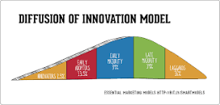
Why - THE DIFFUSIIN OF INNOVATION
it just takes 20% of any group to effect change…

Slide 13
WHY – ITS AN OLD -NEW – BOLD VISION
The wolf shall live with the lamb; the leopard shall lie down with the kid; the calf and the lion will feed^{[b]} together, and a little child shall lead them… ^{\9} They will not hurt or destroy on all my holy mountain, for the earth will be full of the knowledge of the Lord as the waters cover the sea.

